Slide 1
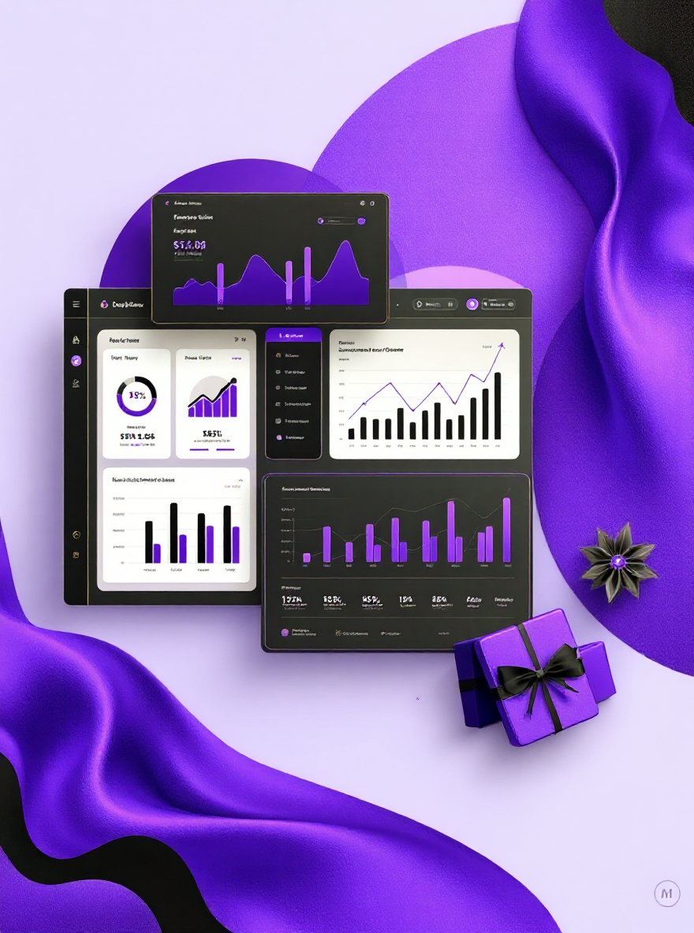
Data-Driven Insights for Sustainable E-Commerce Growth
A comprehensive dashboard analysis and business insights report designed to unlock operational excellence and drive strategic growth through data-informed decision making.
By : Lopita Mishra

Slide 2

Company Background
The company is an e-commerce retailer operating in online retail.
Our e-commerce platform faces multifaceted operational challenges that are creating barriers to sustainable growth and optimal customer satisfaction.
Primary objective: Leverage comprehensive data analytics to identify bottlenecks, optimize performance metrics, and enhance overall customer experience.
Aim: Use data-driven insights to optimize operations & ensure sustainable growth.

Slide 3
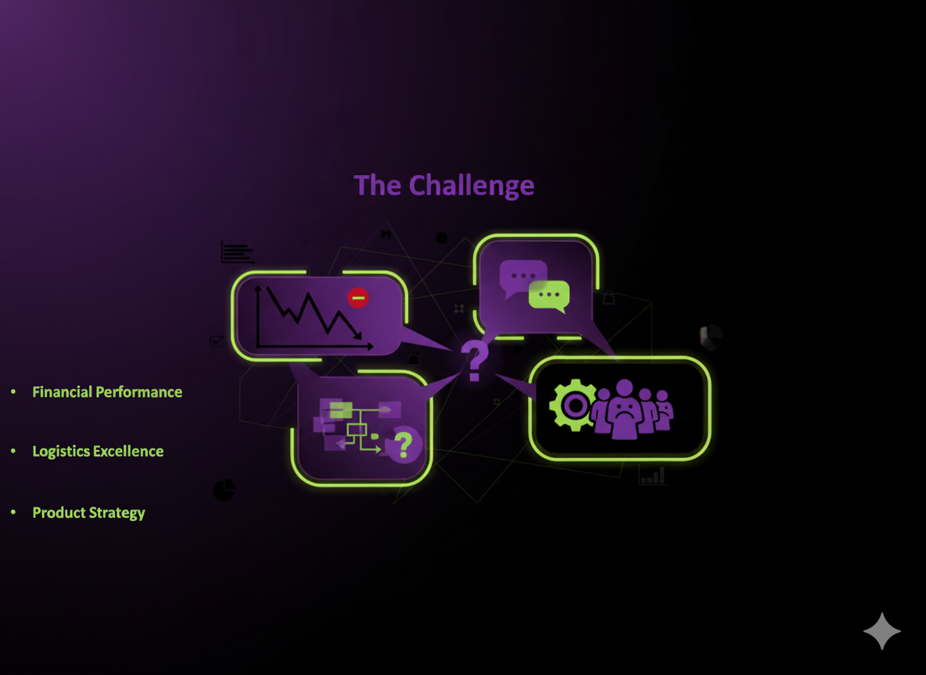
Critical E-Commerce Challenges
Problem statement
The company struggles with:
Managing financial performance (revenue growth, AOV).
Customer insights (retention, cancellations, B2B vs B2C behavior).
Logistics & fulfillment (Amazon vs Merchant, delays).
Product management (demand forecasting, stock control).
Customer satisfaction (returns, cancellations).
The challenges
Financial Performance
Revenue trends and profitability analysis
Customer Insights
Behaviour patterns and segmentation
Logistics Excellence
Fulfillment efficiency and delivery optimization
Product Strategy
Category performance and inventory management
Customer Satisfaction
Returns analysis and service quality metrics

Slide 4
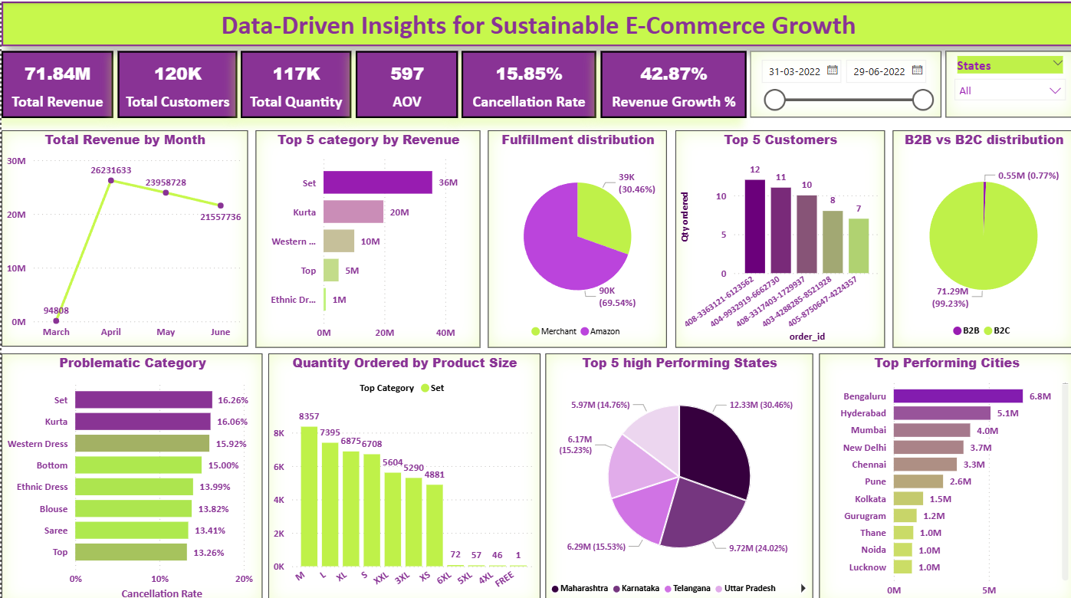
Comprehensive Dashboard Architecture
Strategic KPI Layer
Critical financial and operational health indicators positioned at dashboard summit for immediate visibility and executive decision-making.
Deep-Dive Analytics
Comprehensive charts and visualizations providing granular insights into revenue patterns, customer behaviour, product performance, and logistics efficiency.
Interactive Intelligence
Dynamic filtering capabilities enabling real-time analysis across temporal dimensions, product categories, and geographical segments for targeted insights.

Slide 5
Performance Metrics Dashboard
₹71.84M
117K
120K
₹597
Total Revenue
Total Quantity
Total Customers
Average Order Value
Strong financial performance
Units sold across platform
Active user base
Customer spending pattern
42.87%
15.85%
Revenue Growth
Cancellation rate
Month-over-Month improvement
Area requiring attention
Purpose:
Provide a quick snapshot of overall business performance and key metrics at a glance.
Key Insight:
Revenue is growing well, but high cancellations are hurting overall performance. This is an area that needs urgent improvement.

Slide 6
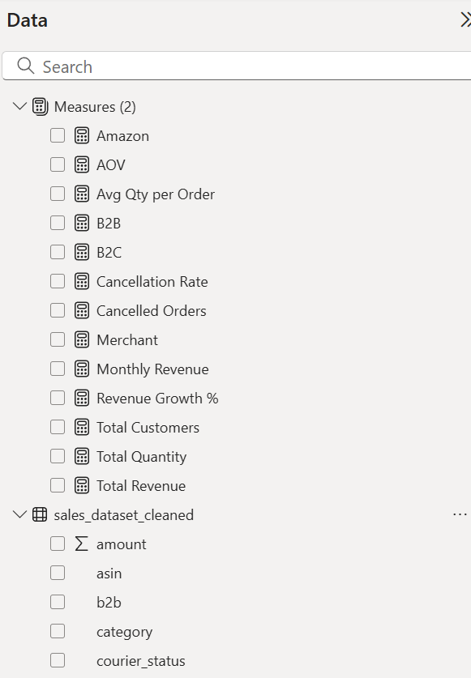
Essential DAX Formula Framework
Revenue Calculations
(measures financial strength)
Total Revenue = SUM(Sales[Amount])
Customer Metrics
(shows how much customers spend per order)
AOV = DIVIDE([Total Revenue], [Total Orders])
Growth Analysis
(tracks business expansion)
Revenue Growth % = DIVIDE( ([Total Revenue] - CALCULATE([Total Revenue], DATEADD(Sales[Date], -1, MONTH))), CALCULATE([Total Revenue], DATEADD(Sales[Date], -1, MONTH)))
Cancellation rate
(signals customer experience issues)
Cancellation Rate = DIVIDE([Cancelled Orders], COUNTROWS
(sales_dataset_cleaned))*100
These foundational formulas enable dynamic calculationa of critical business metrics, facilitating real-time performance monitoring and trend analysis across all dashboard components.

Slide 7
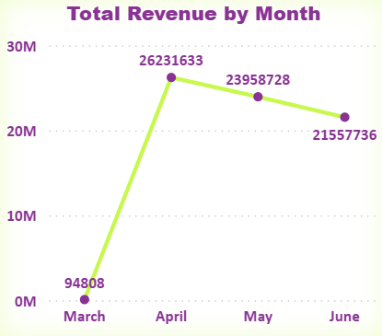
Revenue Trajectory Analysis
Peak Performance
April recorded highest revenue at ₹26 M, indicating successful seasonal campaign execution and market demand alignment.
Strategic Opportunity
Post-peak decline suggests need for sustained engagement strategies beyond traditional seasonal periods to maintain growth momentum.
Purpose:
Track revenue trends.
Key Insight:
Growth peaked in April, slight decline afterwards.

Slide 8
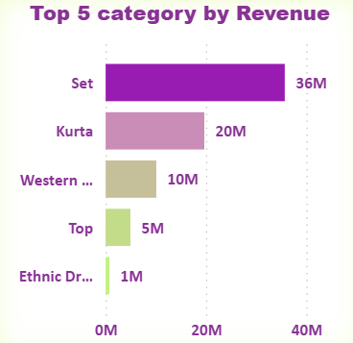
Product Performance Distribution
Critical Analysis
These are the top 5 Product Category by revenue.
Market Concentration Risk:
Sets and Kurta categories dominate with 76% of total revenue, creating vulnerability to market fluctuations.
Top and Western Dress segments show significant untapped potential for expansion and revenue diversification.
Purpose:
To recognize top Product Category.
Key Insight:
Set category has raised the bar with it’s highest Revenue.

Slide 9


Fulfillment Channel Analysis
Strategic Implications
Heavy reliance on Amazon's ecosystem presents both operational efficiency and strategic risk. Whilst benefiting from Amazon's robust infrastructure, this dependency limits pricing flexibility and brand control.
69.5%
Purpose: To compare order fulfillment methods and assess operational dependency.”
Insight: Amazon fulfills ~70% of orders, showing efficiency but creating dependency risk, while Merchant fulfillment handles ~30%.”
Recommendation:
Gradually expand merchant partnerships to achieve 40-60 distribution balance, enhancing operational resilience and market positioning.
Amazon Fulfillment
Primary distribution channel
30.5%
Merchant Network
Direct partnerships

Slide 10
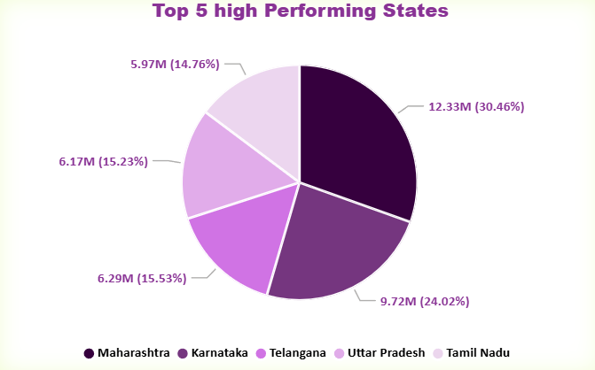
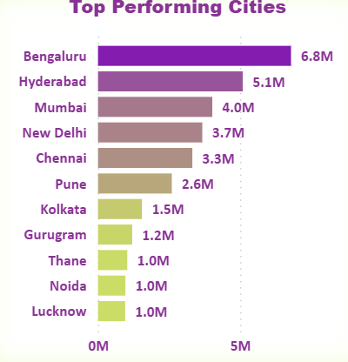
Geographic Revenue Distribution

Slide 11










Purpose:
Identify top-performing regions and cities to understand market concentration and growth opportunities.
Key Insights:
Approx 50% of the revenue comes from just five states, with Maharashtra leading the charge & Southern states demonstrate exceptional market penetration and customer engagement.
Bengaluru
Leading metropolitan market with ~9.5% revenue contribution and strong tech-savvy customer base.
Hyderabad
Secondary powerhouse generating ~7% of total revenue through consistent customer engagement.
Mumbai
Financial capital contributing ~5.6% with high-value customer transactions and premium positioning.
Delhi NCR
Emerging market with ~5.2% share, showing strong growth potential and expanding customer base.
Other Cities
Tier-2 and Tier-3 markets representing a significant untapped expansion opportunities.
Replicate Success : Apply proven strategies from Maharashtra and Karnataka to underperforming regions.
Expand Reach : Launch targeted campaigns in Tier-2 and Tier-3 cities to unlock new revenue streams.

Slide 12
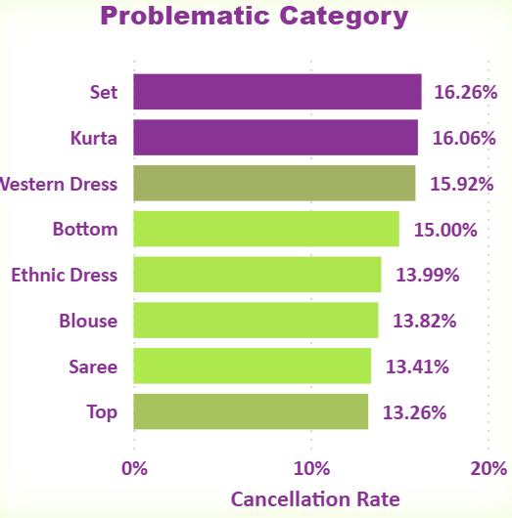
Returns & Cancellations Analysis
Understanding which product categories drive success and which create challenges is crucial for optimising your e-commerce strategy and customer satisfaction.
Purpose:
Track cancellations/returns.
Key Insights:
Sets and Kurtas show significantly higher cancellation rates indicating potential issues with product quality, sizing accuracy.
customer expectations.
Action Required: Implement stricter quality control processes and enhance product descriptions with detailed sizing charts and fabric information.

Slide 13
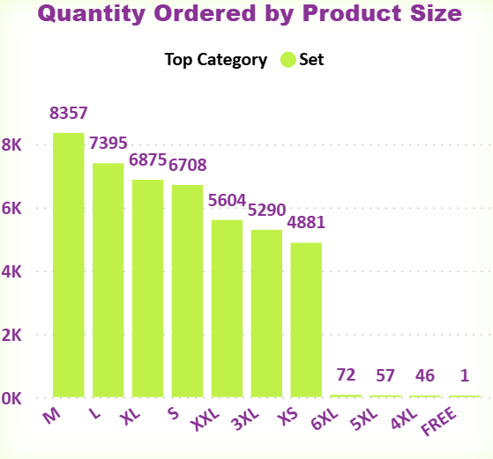
Customer Demand by Size
Size M
Size L
35% of total orders
28% of total orders
Highest demand category
Second most popular
Size XL and Size S
Growing segment
22% of total orders
Purpose:
Purpose: Demand by size.
Key Insight:
Medium, Large, and Extra-Large sizes account for 85% of total orders. This data should drive inventory planning and procurement strategies to ensure optimal stock levels.

Slide 14
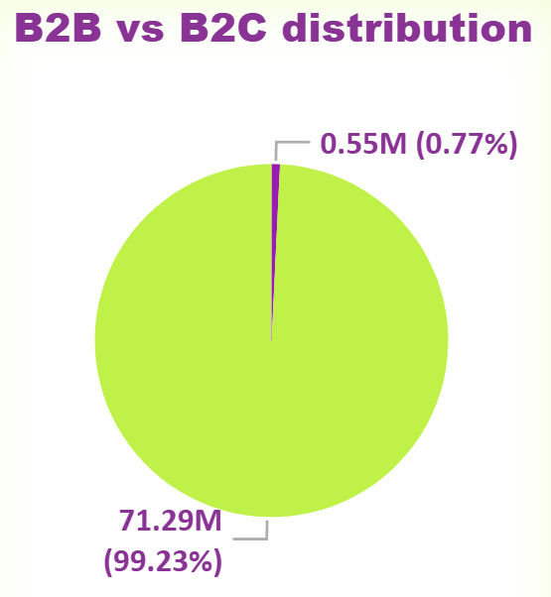

Customer Segmentation & Growth Opportunities
Purpose:
Business Model distribution
Key Insights:
Our business is 99.3% B2C-driven, presenting massive
B2B growth potential worth exploring.
B2B Expansion
Develop digital marketing campaigns targeting retail consumers

Slide 15
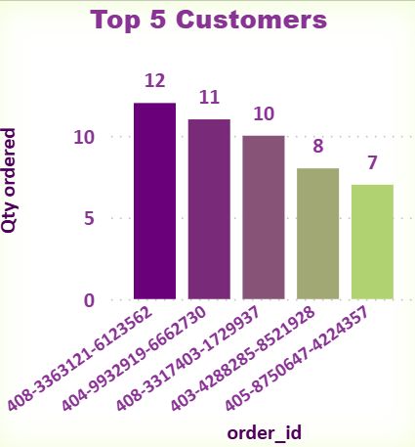
Top Customer Insights
Purpose:
Customer Loyalty Insights
Key Insights :
Top 5 customers average 7-12 orders each, demonstrating
strong repeat purchase behaviour and loyalty.
VIP Programme
Launch exclusive loyalty rewards for high-value customers

Slide 16

Strategic Recommendations & Next Steps
B2B Market Expansion
With 99.3% B2C focus, massive B2C opportunity exists. Develop consumer-focused marketing campaigns and direct-to-consumer channels to capture individual buyer segment.
Product Portfolio Diversification
Reduce category concentration risk by expanding Western Dress and Ethnic Dress segments. Target 40% revenue share from emerging categories within 12 months.
Fulfillment Network Optimization
Diversify beyond Amazon to include multiple fulfillment partners, reducing dependency and improving delivery flexibility.
Returns & Cancellation Reduction
Implement quality control measures and enhanced product descriptions to reduce 20,437 returns and cancellations, improving customer satisfaction and operational efficiency.
Enhance Quality Control
Implement rigorous quality checks for Sets and Kurtas to minimize returns and improve customer satisfaction.
Align Inventory Strategy
Focus procurement on high-demand sizes (M, L, XL) and successful categories to maximise inventory turnover.

Slide 17
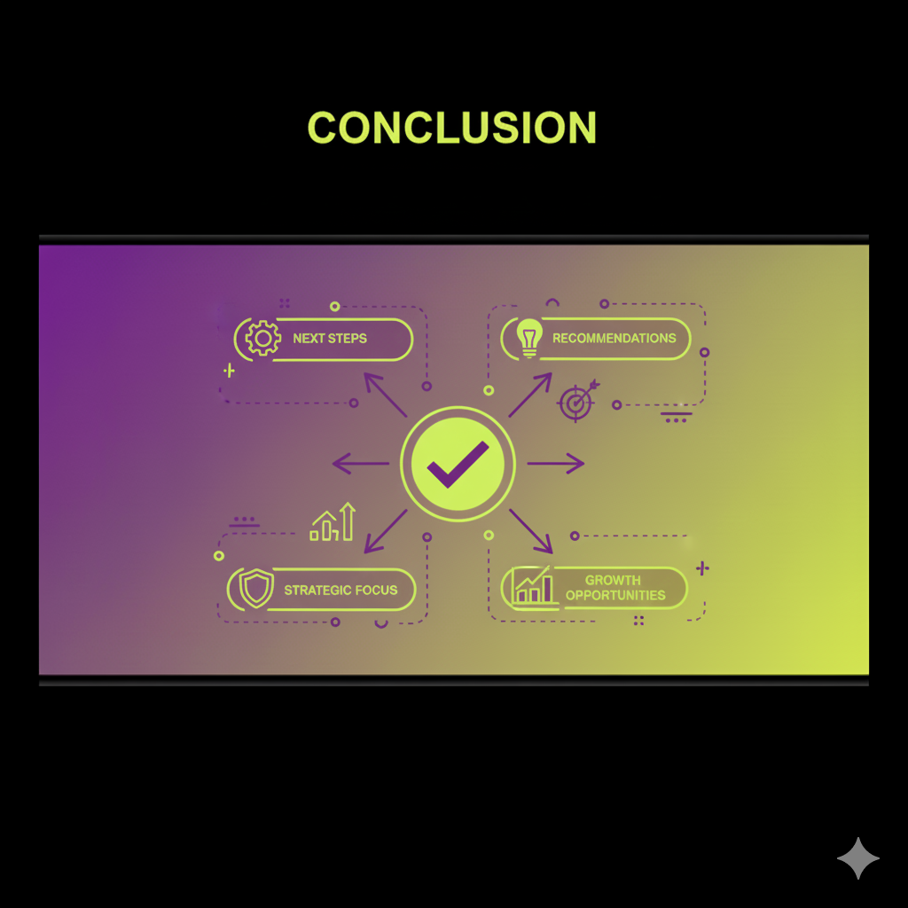
Conclusion
Revenue Trends: Total revenue crossed ₹71M, with a peak of ₹26M in April, followed by a decline to ₹21M in June, indicating seasonal fluctuations.
Category Performance: “Set” contributed the most (₹36M, ~50% of total revenue) but also had one of the highest cancellation rates (~16.26%).
Fulfillment: Amazon fulfilled ~70% (90K orders), creating operational dependency, while merchants handled only 30% (40K orders).
Customer Mix: Business is heavily skewed to B2C (~99%, ~₹70M), with B2B contributing only 1% (~₹0.55M).
Problematic Areas: Set & Kurta faced cancellations exceeding 16%.
Size Demand: Medium, Large, and XL sizes dominated with >22K orders combined, while XS/XXL lagged.
Geographical Insights:
States: Maharashtra led with ~₹12.3M (30%), followed by Karnataka (₹9.7M).
Cities: Bengaluru topped with ₹6.8M revenue, followed by Hyderabad (₹5.1M) and Mumbai (₹4M).

Slide 18

Dashboard Impact & Next Steps
360° Business Visibility
This comprehensive dashboard provides complete visibility into revenue streams, customer behaviour, logistics performance, and product analytics enabling data-driven decision making across all business functions.
Revenue Optimisation
Track performance across channels and regions
SUCCESS
Operational Excellence
Monitor logistics and product performance metrics
Customer Intelligence
Identify high-value segments and retention opportunities

Slide 19
Thank You
Name : Lopita mishra
Email Id: lopitamishra2001@gmail.com
GitHub : MLopita (Lopita Mishra) · GitHub
LinkedIn : https://linkedin.com/in/lopita-mishra-096534191
Portfolio: https://lopita-mishra-portfolio.netlify.app/

